Slide 1
932
932
Q
Can we adopt CSMA/CD (used in wired Ethernet) for use in wireless networks
MAC for wireless networks
Notes:
The answer is no (and will be clarified next).

Slide 2
Last Lecture: Binary Exponential Back-off
Each station assumes a back-off period after collision/contention
Since back-off times are random, all stations choose a different back-off time and do not attempt to use the channel at the same time
After n^{th} collision, station chooses a time period between 0 and 2^{n} -1 slot times
Truncated exponential back-off limits the back-off period to a certain threshold
Notes:
DCF like 802.3 or Ethernet’s CSMA/ CD is random-access and does not provide any timing guarantees. This does not lend itself to real-time or ‘fair’ communications over 802.11.
In situations, where we need fair or deterministic access to the medium, PCF can be used. However, PCF is only usable in Infrastructure based WLANs and is also commonly not implemented. The point-coordinator (on which PCF is based) is usually implemented on the AP and therefore is centralized.
The most common implementation of the 802.11 mode is of the DCF mode.
It is important to note here that PCF is contention free and DCF is contention-based.
PCF and DCF can co-exist as well when PCF is implemented.
Paper which describes about MAC being Unfair
http://www-inst.eecs.berkeley.edu/~ee228a/fa03/228A03/802.11%20wlan/fair_scheduling.pdf

Slide 3
Analogy: Wired vs. Wireless
Wireless networks:
The signal is attenuated more intensively and the signal may not reach all parts of the network
Wired network:
The signal propagates to all parts of the network
Notes:
To explain the difference between wired networks and wireless networks, we can use the analogy of humans conversing.
In a wired network, the transmitted signal is not attenuated as much as in wireless networks, furthermore, wired networks are built such that a network signal transmitted at one end of the network will eventually reach the other end of the network (even if there’s some delay). The human conversation analogy here would be that the speaker has a magic microphone that can increase its volume arbitrarily to the level where the voice is heard everywhere in the network. Although, the voice is heard everywhere in the network, there can be some propagation delay between the transmission time and receiving time.
However, this is not the case in wireless networks, in which the transmission medium attenuates the signals much more. Depending on the transmission power, the signal propagates only a certain distance and beyond it, the signal strength becomes so low that it cannot be received correctly. This means that multiple transmission can go on in parallel in different parts of the network as long as the communicating parties are outside each other’s transmission range. The human conversation analogy would be communication without the usage of microphone where two conversations can go in parallel as long as they are spatially distant.

Slide 4
Analogy: Wired vs. Wireless
The man in the middle can’t hear both the speaking men (their speech is muddled).
The speakers cannot detect each other and they will keep on talking not detecting the problem at the listener.
Notes:
To explain the difference between wired networks and wireless networks, we can use the analogy of humans conversing.
In a wired network, the transmitted signal is not attenuated as much as in wireless networks, furthermore, wired networks are built such that a network signal transmitted at one end of the network will eventually reach the other end of the network (even if there’s some delay). The human conversation analogy here would be that the speaker has a magic microphone that can increase its volume arbitrarily to the level where the voice is heard everywhere in the network. Although, the voice is heard everywhere in the network, there can be some propagation delay between the transmission time and receiving time.
However, this is not the case in wireless networks, in which the transmission medium attenuates the signals much more. Depending on the transmission power, the signal propagates only a certain distance and beyond it, the signal strength becomes so low that it cannot be received correctly. This means that multiple transmission can go on in parallel in different parts of the network as long as the communicating parties are outside each other’s transmission range. The human conversation analogy would be communication without the usage of microphone where two conversations can go in parallel as long as they are spatially distant.

Slide 5
Why not perform CD?
1) Collision detection is hard in wireless networks
2) All collisions cannot be detected at the sender (hidden node problem)
Collision Avoidance: avoid collisions in the first place
Notes:
If you recall from yesterday’s lecture, Ethernet (802.3) standard requires user to detect collisions (or perform collision detection – abbreviated as CD). This is done by monitoring the link while transmitting. If the link contains some other signals other than the signal being transmitted, the sending node can assume that a collision has taken place. This process of monitoring the link while transmitting is called collision detection.
In Ethernet, whenever a collision is detected, the transmissions are aborted since there is no use in carrying out a corrupted transmission.
In wireless LAN (802.11), on the other hand, it’s hard to detect collisions because the received wireless signal is very weak (up to 1000 times weaker than the signal being transmitted); it’s expensive to build hardware than can detect such a weak signal when a higher-power signal is being transmitted. In any case, building a half-duplex receiver (which sends or receives at a time) is much cheaper than building a full-duplex receiver (which sends/ receives at the same time). Also, in wireless networks, a stronger signal captures or overwhelms a weaker signal.
Even assuming that adapter is able to implement a cheap solution that can transmit and sense other transmissions at the same time (and abort a colliding transmission), the adapter will not be able to detect all collisions due to the hidden node problems and the fading problem.
Since, 802.11 does not detect collisions, it sends frame in its entirety. Collisions, therefore, are more expensive than in 802.3 since a colliding transmission is not aborted early.
Accordingly, in 802.11, the focus is on avoiding collisions by taking a-priori steps. This can include exchanging of small control packets (which we will cover in the next slide) that can solve the hidden node problem. Also, in 802.11, when a node has sensed that the medium is busy, it is more conservative in transmitting (i.e., it does not immediately transmit as it sees the link idle but waits for a while)

Slide 6
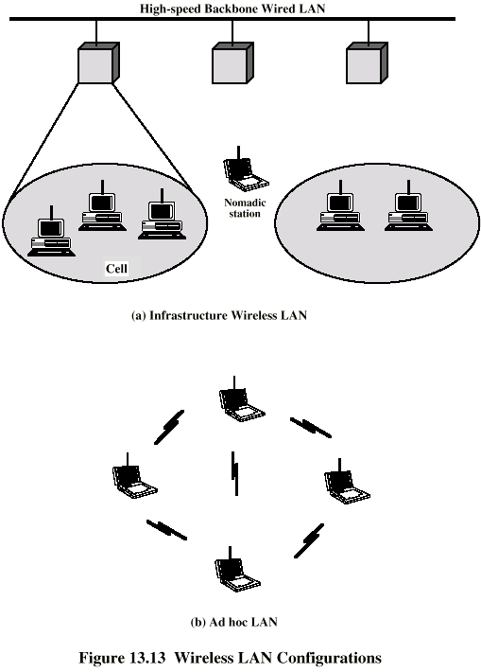
Wireless LAN Configuration

Slide 7
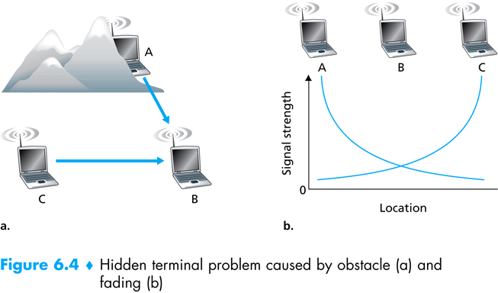
Hidden Node Problem
Collisions (undetected) at receiver due to a hidden transmitter
Hidden node
Caused by Obstacle
Caused by Signal Attenuation
Figure adapted from: Kurose, Ross, “Computer Networking: a Top Down Approach”
Notes:
Assume that A and C are outside the transmission range of each other and they both want to communicate with B. If A and C transmit at the same time, they will not be able to detect a collision since they are outside each others transmission range; this will lead to a collision at the receiver (B).
This problem is called a hidden node problem since the transmission is collided to by a transmission of another hidden node. The hidden node problem creates a collision at the receiver.

Slide 8
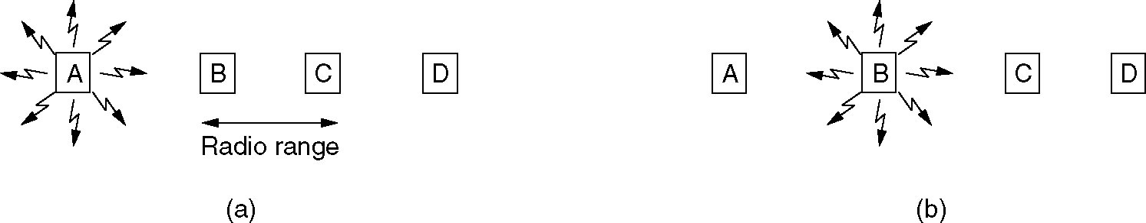
Hidden Node Problem
‘A’ and ‘B’ are in each others range and can interfere
‘C’ can communicate and interfere with ‘B’ and ‘D’ but not ‘A’

Slide 9
Hidden Node Problem
Consider the case when ‘A’ transmits to ‘B’
‘C’ does not detect the transmission from ‘A’ because it is out of range
‘C’ falsely concludes that it can transmit
If ‘C’ transmits, it interferes at ‘B’ with the transmission from ‘A’ garbling information
The problem of a station not being able to detect a potential competitor because of being distant is the ‘Hidden Node Problem’

Slide 10
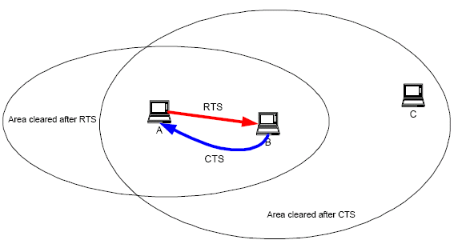
HN Problem’s solution
Exchange of control (RTS/ CTS packets)
Figure Credits: Mustafa Ergen
Notes:
Assume that A and C are outside the transmission range of each other and they both want to communicate with B. If A and C transmit at the same time, they will not be able to detect a collision since they are outside each others transmission range; this will lead to a collision at the receiver (B).
This problem is called a hidden node problem since the transmission is collided to by a transmission of another hidden node. The hidden node problem creates a collision at the receiver.

Slide 11
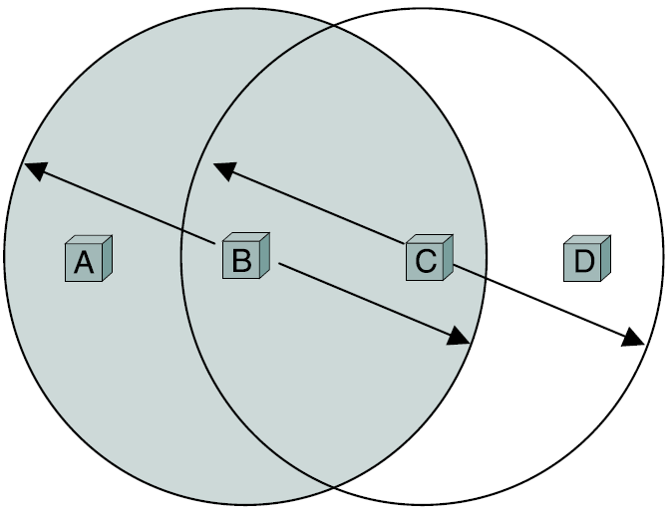
Exposed Node Problem
Wasted bandwidth due to proximity to a transmitting node
Figure adapted from: Peterson/ Davie: “Computer Networks – A Systems Approach”
Notes:
A related problem, called the exposed node problem, occurs under the following circumstances. Suppose B is sending to A in the figure above. Node C is aware of this communication because it hears B’s transmission. It would be a mistake for C to conclude that it cannot transmit to anyone just because it can hear B’s transmission. For example, suppose C wants to transmit to node D. This is not a problem since C’s transmission to D will not interfere with A’s ability to receive from B. (It would interfere with A sending to B, but B is transmitting in our example.)
Note that the exposed node problem does not cause a collision but causes reduced throughput for other transmitters (those transmitters who are exposed to another transmission). Hidden node, on the other hand, creates the problem of collisions.

Slide 12
Exposed Node Problem
Consider the reverse situation
‘B’ transmitting to ‘A’
If ‘C’ senses the transmission, it could falsely conclude that the medium is busy
It does not send to ‘D’ when the line between ‘C’ and ‘D’ is idle
It is termed as ‘Exposed Node Problem’

Slide 13
Exposed Node Solution
Wasted bandwidth due to proximity to a transmitting node
CTS
RTS
Figure adapted from: Peterson/ Davie: “Computer Networks – A Systems Approach”
Notes:
A related problem, called the exposed node problem, occurs under the following circumstances. Suppose B is sending to A in the figure above. Node C is aware of this communication because it hears B’s transmission. It would be a mistake for C to conclude that it cannot transmit to anyone just because it can hear B’s transmission. For example, suppose C wants to transmit to node D. This is not a problem since C’s transmission to D will not interfere with A’s ability to receive from B. (It would interfere with A sending to B, but B is transmitting in our example.)
Note that the exposed node problem does not cause a collision but causes reduced throughput for other transmitters (those transmitters who are exposed to another transmission). Hidden node, on the other hand, creates the problem of collisions.

Slide 14
Exposed Node Solution
Wasted bandwidth due to proximity to a transmitting node
IEEE 802.11 RTS/CTS mechanism helps to solve this problem only if the nodes are synchronized and packet sizes and data rates are the same for both the transmitting nodes.
When a node hears an RTS from a neighboring node, but not the corresponding CTS, that node can deduce that it is an exposed node and is permitted to transmit to other neighboring nodes.
If the nodes are not synchronized (or if the packet sizes are different or the data rates are different) the problem may occur that the sender will not hear the CTS or the ACK during the transmission of data of the second sender.
Source: Wikipedia
Notes:
A related problem, called the exposed node problem, occurs under the following circumstances. Suppose B is sending to A in the figure above. Node C is aware of this communication because it hears B’s transmission. It would be a mistake for C to conclude that it cannot transmit to anyone just because it can hear B’s transmission. For example, suppose C wants to transmit to node D. This is not a problem since C’s transmission to D will not interfere with A’s ability to receive from B. (It would interfere with A sending to B, but B is transmitting in our example.)
Note that the exposed node problem does not cause a collision but causes reduced throughput for other transmitters (those transmitters who are exposed to another transmission). Hidden node, on the other hand, creates the problem of collisions.

Slide 15
Wired Vs. Wireless
Popular CSMA/CD scheme is not applicable to wireless networks
Doesn’t work well on a wireless network because of:
Varying Link Quality
Hidden and Exposed Terminal Problems
Tradeoff between Packet Length and Errors

Slide 16
Wireless MAC Challenges: Varying Link Quality
Wireless links encounter time-varying quality degradation because of:
Noise from other devices operating in the same spectrum
Multipath fading
Signal attenuation
Popular CSMA/CD (Carrier Sense Multiple Access/Collision Detection) scheme is not applicable to wireless networks
Specific MAC protocols for the access to the physical layer

Slide 17
Wireless MAC Challenges: Hidden and Exposed Terminal Problems
Unlike wired networks, interference is a receiver-based phenomenon in wireless networks
Interference at the receiver means the collision of the packets arriving at the receiver
It is virtually impossible for the sender to know the link status at the receiver
Consequently, collision detection does not work very well on wireless channels
Notes:
Collision at the receiver

Slide 18
Tradeoff between Packet Length and Error
For the same probability of error, packets of longer length are less likely to be successfully transmitted
For a channel with probability of bit-error=ε, the probability of an error-free packet of length L bits is:
Pr {err-free pkt of length L bits} = (1- ε)^{L}

Slide 19
Wireless MAC Challenges: Tradeoff between Packet Length and Error
ε =0.001
Bandwidth efficient solution to this problem:
Solution: Fragment long packets into multiple fragments/frames

Slide 20
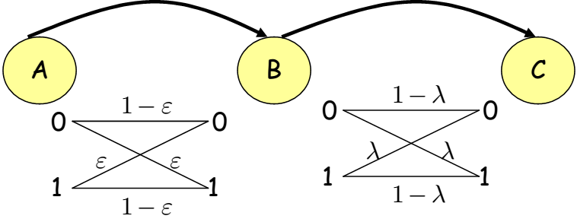
Wireless MAC Challenges: Tradeoff between Packet Length and Error
Consider the 2-hop wireless network shown below. The channel between nodes A and B is a binary-symmetric wireless channel with a probability of bit-error ε. The channel between nodes B and C is also binary-symmetric, but with a probability of bit-error λ. We want to transmit a packet of length L bits from node A to node C. What is the probability that the packet will be received at node C without any bit-errors?
Notes:
Four events are possible in the above setup:
The following four events are possible in the abovesetup:
event 1 = good pkt on hop 1 ∩ good pkt onhop 2 ,
event 2 = good pkt on hop 1 ∩ bad pkt on hop 2 ,
event 3 = bad pkt on hop 1 ∩ good pkt on hop 2 ,
event 4 = bad pkt on hop 1 ∩ bad pkt on hop 2 .
Among the above four events only event 1 leads to reception of a good packet (i.e., packet
without any bit-errors) at node C. Since bit-errors on both hops are independent, we can
write the probability of event 1 as:
Pr (good pkt on hop 1 ∩ good pkt on hop 2)

Slide 21
Wireless MAC Challenges: Tradeoff between Packet Length and Error
The following four events are possible in the abovesetup:
event 1 = good pkt on hop 1 ∩ good pkt onhop 2 ,
event 2 = good pkt on hop 1 ∩ bad pkt on hop 2 ,
event 3 = bad pkt on hop 1 ∩ good pkt on hop 2 ,
event 4 = bad pkt on hop 1 ∩ bad pkt on hop 2 .
Among the above four events only event 1 leads to reception of a good packet (i.e., packet without any bit-errors) at node C. Since bit-errors on both hops are independent, we can write the probability of event 1 as:
Pr (good pkt on hop 1 ∩ good pkt on hop 2)

Slide 22
[ End of lecture ]

